Slide 1
The Base Erosion Profit Shifting Project and the 2030 Sustainable Development Agenda
Irma Johanna Mosquera Valderrama 19 December 2018
Associate Professor of Tax Law– Principal investigator EU-ERC GLOBTAXGOV

Slide 2
Topics
ERC-GLOBTAXGOV
Good Governance in tax matters and BEPS
Tax and Development

Slide 3
A New Model of Global Governance in International Tax Law Making
Research Project awarded Starting Grant by the European Research Council
The ERC Starting and Consolidator Grants are part of the main ERC frontier research grants 2019 funded by the European Union's Horizon 2020 Framework Programme for Research and Innovation. The ERC's main frontier research grants aim to empower individual researchers and provide the best settings to foster their creativity. Scientific excellence is the sole criterion of evaluation.
Period February 2018- January 2023
Team
Principal Investigator Irma Johanna Mosquera Valderrama
PhDs researchers Adrian Grant and Frederik Heitmüller
Postdoctoral researcher
Host Institution: Institute of Tax Law and Economics, Leiden University, the Netherlands

Slide 4
TAX GOVERNANCE – OECD and G20
4 Minimum standards
10 Best practices
1 Multilateral Convention
INCLUSIVE FRAMEWORK
BASE EROSION PROFIT SHIFTING (BEPS) Decision making: BEPS 44 GROUP
G20
OECD
SIGNATORIES
124
COUNTRIES
85 COUNTRIES

Slide 5
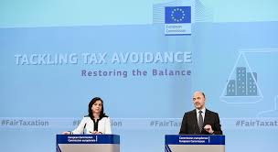
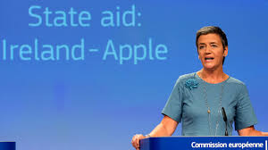
TAX GOVERNANCE: EU AND THIRD COUNTRIES
Anti-Tax Avoidance Directives
State Aid Investigations
Fair Tax Competition

Slide 6
RESEARCH QUESTION
Under what conditions can the OECD-G20 and the EU models of global tax governance be feasible and legitimate for both developed and developing countries?

Slide 7
Research objectives
To investigate the transplant of the 4 minimum standards
To investigate the conditions under which the OECD can set standards in the current model of global tax governance
To investigate the legitimacy of the EU initiatives with respect to EU and third (non-EU) countries

Slide 8
Good governance in tax matters and BEPS 2016
Criteria for the establishment of the EU list of non-cooperative jurisdictions for tax purposes: Transparency, Fair Taxation, Implementation of anti-BEPS measures
Initial criterion: for the jurisdiction to commit by the end of 2017, to the agreed OECD anti-BEPS minimum standards and their consistent implementation.
Future criterion (to be applicable once the reviews by the Inclusive Framework of the agreed minimum standards are completed) for the jurisdiction to receive a positive assessment for the effective implementation of the agreed OECD anti-BEPS minimum standards.
Annex to the ECOFIN Council Conclusions of 8 Nov. 2016, 14166/16, FISC 187, ECOFIN 1014, at 7. http://data.consilium.europa.eu/doc/document/ST-14166-2016-INIT/en/pdf

Slide 9
Good governance in tax matters and BEPS 2018
The Parties recognise and commit themselves to implement the principles of good governance in the tax area, including the global standards on transparency and exchange of information, fair taxation, and the minimum standards against Base Erosion and Profit Shifting (BEPS).
The Parties will promote good governance in tax matters, improve international cooperation in the tax area and facilitate the collection of legitimate tax revenues.
26 April 2018, ECOFIN Council 8644/18 FISC 180

Slide 10
Tax and development
Taxation linked to good governance?
EU as a major political and economic player internationally: To support implementation of international standards (exchange of information and BEPS) smooth and timely in the single market and internationally
Taxation linked to development?
To facilitate the collection of tax revenues (DRM)
Communication from the Commission to the European Parliament and the Council on an External Strategy for Effective Taxation COM/2016/024 final at 5
To assess how BEPS contributes to achieve the 2030 Sustainable Development Agenda?

Slide 11
Tax and development
Were the Sustainable Development Goals (SDGs) and the interests of developing countries to attract investment considered throughout the BEPS Process?
How the implementation of BEPS will contribute to achieve the SDGs?
What issues of international taxation, beyond BEPS, should be addressed to fulfill developing countries' need to achieve the 2030 Agenda for Sustainable Development?
Is the approach to technical assistance holistic and inclusive? How this approach relates to Medium Term Revenue Strategies. How to strengthen the cooperation between countries and donors?

Slide 12
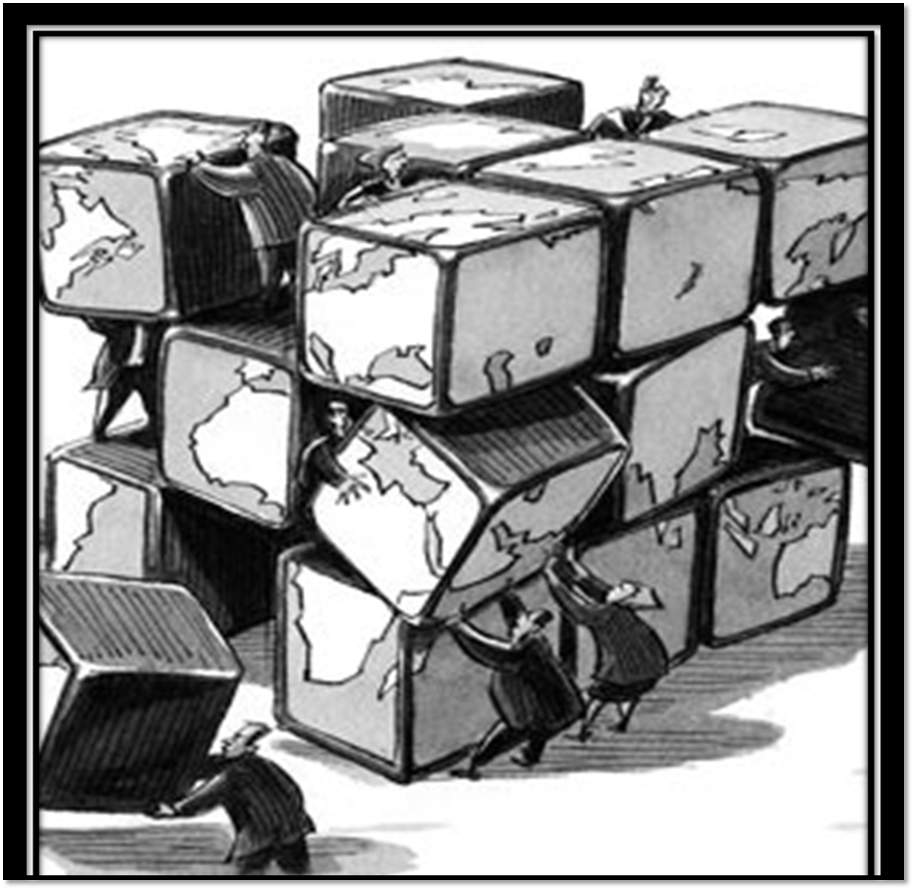
EUROPEAN UNION
EU leadership
Fair and efficient corporate taxation
Better-tailored partnerships
New model of Governance
12

Slide 13
Further reading and workshop
Mosquera Valderrama I.J., Lesage, D., Lips & W. (2018), Tax and Development: The Link between International Taxation, The Base Erosion Profit Shifting Project and The 2030 Sustainable Development Agenda, no. W-2018/3. Bruges, Belgium: UNU Institute on Comparative Regional Integration Studies (CRIS). Available at http://cris.unu.edu/sites/cris.unu.edu/files/W-2018-4.pdf
Workshop on Tax and Development: The Link between International Taxation, the Base Erosion Profit Shifting Project and the 2030 Sustainable Development Agenda at United Nations University CRIS http://cris.unu.edu/workshop-tax-and-development-link-between-international-taxation-base-erosion-profit-shifting
Mosquera Valderrama I.J., The EU standard of good governance in tax matters for third (non-EU) countries. Intertax Forthcoming 2019.

Slide 14
Twi
Visit us at
Leiden University, Institute of Tax Law and Economics
GLOBTAXGOV project receives funding from the EU H2020 Research & Innovation Programme and European Research Council
Blog https://globtaxgov.weblog.leidenuniv.nl/
Twitter: @GLOBTAXGOV @IrmaMosqueraV

