Slide 1
Taxation for equality: the case for progressive taxation
Hannah Brejnholt Tranberg
19/12/2018

Slide 2
Taxation for equality: the case for progressive taxation
Equality and progressive taxation
ActionAid’s briefings on progressive taxation
Why progressive taxation is important for developing countries
What can the EU and Member States do?

Slide 3
1 – Equality and progressive taxation
We want progressive tax systems that distribute contributions fairly and serve to bridge economic and gender inequalities.
What is progressive taxation? Higher tax rates for those with higher income or more wealth.
Taxes can be made more progressive with well-designed scales, exemptions and thresholds. What matters for the overall progressiveness of a tax system is the mix of different types of taxes and the rates applied to them.

Slide 4
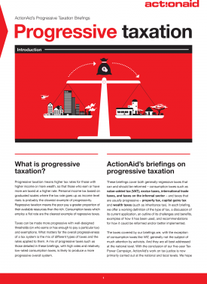
2 - Our briefings on progressive taxation
We have developed eight briefings:
Introduction to Progressive Taxation
Value-added tax (VAT)
Capital gains tax
International trade taxes
Taxes on the informal sector
Property tax
Excise taxes
Wealth taxes
Upcoming: personal income tax and corporate income tax

Slide 5
3 - Importance for developing countries
Domestic resource mobilisation is vital to financing development and the SDGs.
How tax is raised matters: regressive taxes risk pushing people into poverty, and risk worsening economic inequalities – unless offset by strongly progressive spending.
The value-added tax (VAT) as an example: increasing evidence of the disproportionate impact that it can have on the poor.
Despite this, at the moment, developing countries tend to increasingly rely on VAT and other consumption taxes.

Slide 6
3 - Importance for developing countries - cont'd
For example, between 2012 and 2016, Uganda raised more than a third of its total tax revenues from VAT, while Ghana raised about 29%.
In comparison, in the EU, the contribution of VAT to total tax revenue averages only 17.5%.
Developing countries’ increasing reliance on consumption taxes is accompanied by a massive scale of tax avoidance and tax evasion.
This effectively means that the balance of contributions is shifted towards those earning less.

Slide 7
3 - Importance for developing countries - cont'd
There is no one-size-fits-all solution for a progressive tax system. However, governments should ensure that their tax systems do not reinforce gender and economic inequalities.
Our recommendations:
Impact analyses on how implementation of a specific tax will affect different segments of society
Better communication to the public about taxes and how they are spent
Well-resourced and trained tax administrations
Transparency – towards other tax authorities as well as towards the public

Slide 8
4 - What the EU and Member States can do
In the new European Consensus on Development, the EU and Member States have committed to “work with partner countries to promote progressive taxation and redistributive public policies”.
Two key ways in which EU countries can do so:
by playing their part in curbing tax avoidance and evasion by corporations and wealthy individuals. Leading by example, including by ensuring a high degree of Policy Coherence for Development, is essential;
through aid to domestic resource mobilisation, including budget support or collaboration with other international and regional organisations.

