Slide 1

Gaëlle Garnier
Deputy Head of Unit
Economic analysis, evaluation & impact assessment support
DG TAXUD

Slide 2


Fairness
Efficiency

Slide 3
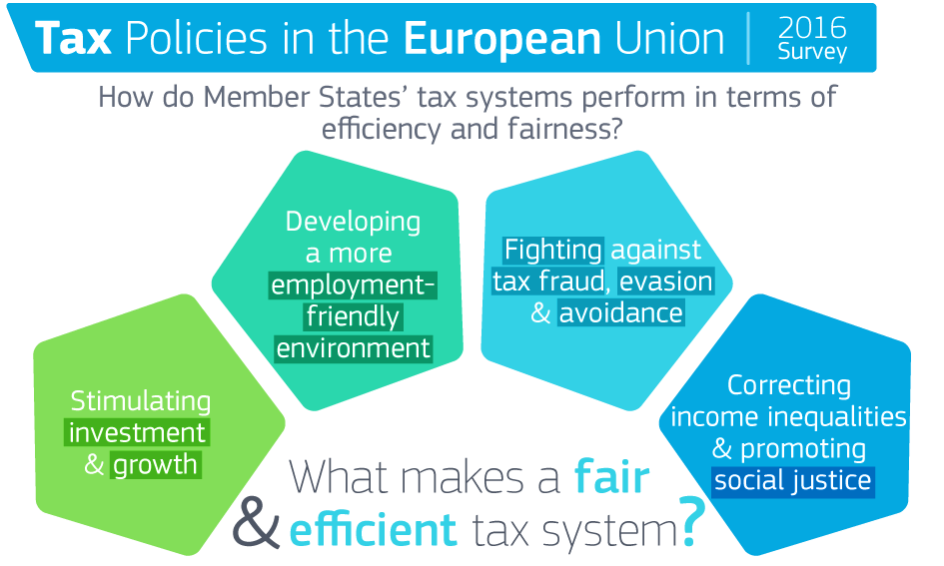
Link: https://ec.europa.eu/taxation_customs/sites/taxation/files/tax_policies_survey_2016.pdf

Slide 4

From taxation to knowledge creation
Keynote speech by Bronwyn H. Hall, Professor of Economics at University of California Berkeley
Panellists: Karen Helene Ulltveit-Moe, Professor, Department of Economics, University of Oslo, Giorgia Maffini, Deputy Head, Tax Policy and Statistics Centre for Tax Policy and Administration at OECD
Moderator: Ruud de Mooij, Division Chief, Tax Policy Division of IMF’s Fiscal Affairs Department

Slide 5

Growing innovation leaders
Keynote speech by Alexander De Croo, Deputy Prime Minister of Belgium and minister of Development Cooperation, Digital Agenda, Telecom and Postal Services
Panellists: Philipp Steinberg, Director General Economic Policy at the Federal Ministry for Economic Affairs and Energy – Germany, Amal Larhlid, Director Policy and Governance at PwC
Moderator: Victoria Perry, Assistant Director in the Fiscal Affairs Department of the International Monetary Fund

Slide 6
No collaboration without taxation?
Keynote speech by Alessandra Casarico, Professor at Bocconi University
Panellists: Frederic Mazzella, CEO of Blablacar, Marek Helm, Director General of the Estonian Tax and Customs Board, Rebecca Filis, Swedish Tax Agency
Moderator: Irmfried Schwimann, Deputy Director General – DG GROW, European Commission

Slide 7
Robotax vs cybefraud?
Keynote speech by Rita de la Feria, Professor of Tax law at the University of Leeds
Panellists: Merel Berling, Manager at the Centre for Compliance and Risk Management of the Netherlands; Matthias Petutschnig, Assistant Professor at Tax Management group, Vienna University of Economics and Business
Moderator: Stephen Quest, Director General - DG Taxation and Customs Union, European Commission

Slide 9
What's next?
Ongoing studies on:
  tax incentives for VC and BA
  entrepreneurship & collaborative economy
Conference on tax fairness (2017)

