Slide 1
Tax & Payments to Governments
Draft GRI Standard
Mia d’Adhemar
26 March 2019

Slide 2
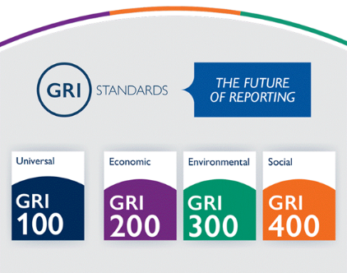
Who We Are
We are an international independent organization that has pioneered sustainability reporting for two decades.
The GRI Standards represent global best practice for reporting sustainability information – enhancing its comparability and quality.

Slide 3
The GRI Standards
The GRI Sustainability Reporting Standards are designed to help communicate about an organization’s impacts on the economy, the environment, and society
GRI
Business
Labor
Civil Society
Investors
Mediating instns
The GRI Standards are developed through a transparent, multi-stakeholder process, following the Due Process of the Global Sustainability Standards Board (GSSB) – GRI’s independent standard-setting body

Slide 4
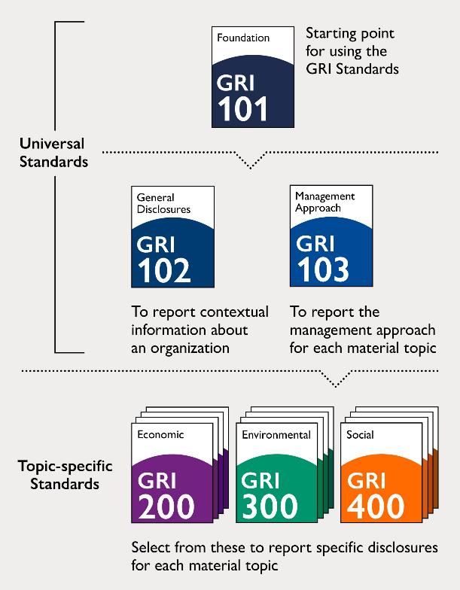
Overview of the GRI Standards
Structured as a set of interrelated, modular standards
3 universal Standards that apply to every organization preparing a sustainability report
33 topic-specific Standards (on e.g., water, occupational health and safety, anti-corruption) for reporting on the identified material topics
Organizations select and use only the relevant topic-specific Standards, based on their material topics
reflect the reporting organization’s significant economic, environmental, and social impacts; or
substantively influence the assessments and decisions of stakeholders.

Slide 5
Our impact
128
60
75%
250
33,000+
500
22
50
68
51,322
100
315
around
57
500

Slide 6
Converging on a Single Global ESG Standard
G250 – Largest 250
companies in the world by revenue
N100 – Largest 100
Companies by revenue in 49 countries
Source: KPMG Survey, 2017

Slide 7
Tax and Payments to Governments
Project overview
In 2017, the Global Sustainability Standards Board (GSSB) initiated a project on tax and payments to governments.
The aim of this work is to:
develop new, specific disclosures related to tax and payment to governments, which will be considered for incorporation into the GRI Standards.
promote greater transparency on a reporting organization’s approach to taxes, including potential elements such as tax strategy, governance, and information on actual taxes paid or payments to governments.

Slide 8
Tax and Payments to Governments
Project overview
Technical Committee:
Daniel Bertossa, Public Services International France
Alex Cobham, Tax Justice Network, UK
Andy Cale, Vodafone Group Plc, UK
Eelco van der Enden, Tax Policy Group, Accountancy Europe and PwC, Netherlands
Richard Murphy, City University, London, and Tax Research UK, UK
Vaishnavi Ravishankar, UN PRI, UK
Rob Wilson, MFS Investment Management, USA
Since January 2018, the multi-stakeholder Technical Committee has been working to develop a draft of a new topic-specific Tax and Payments to Governments Standard.
A preliminary draft Tax and Payments to Governments Standard was ‘field tested’ in July and August 2018.
Public exposure draft approved by the GSSB on 29 November 2018.
90-day public comment on the exposure draft closed on 15 March 2019.
85 submissions from ~110 organisations across business, investment institutions, civil society, labor & mediating institutions.*
*Only includes organizations that have directly signed their name to a submission and does not include the number of organizations represented by a peak body who have submitted feedback

Slide 9
Overview of proposed disclosures
Exposure draft
The first global standard to combine management approach disclosures on tax strategy, with public country-by-country reporting of income, taxes, and business activities.
Management approach disclosures
Disclosure 1- Approach to tax and payments to governments
Disclosure 2- Tax governance, control, and risk management
Disclosure 3- Stakeholder engagement and management of concerns related to tax and payments
Topic-specific disclosures
Disclosure 4- Entities and activities by tax jurisdiction
Disclosure 5- Country-by-country reporting
Each disclosure can have additional requirements on how to compile or present the information, along with recommendations (e.g. aspirational/ best-practice approaches), and guidance

Slide 10
Reporting requirements
Disclosure XXX-1
Disclosure XXX-2
Disclosure XXX-3
A description of the approach to tax and payments to governments, including:
whether the organization has a tax strategy and where it is available;
the body or position that reviews and approves the tax strategy, and the frequency of this review;
the approach to regulatory compliance;
how the tax strategy is linked to the business and sustainable development strategies.
A description of the tax governance and control framework, including:
body or position accountable for compliance with tax strategy;
how the stated approach is embedded;
the approach to tax risks;
how compliance with the governance and control framework is evaluated.
A description of the mechanisms for reporting concerns.
A description of the assurance process for disclosures.
A description of the approach to stakeholder engagement and management of stakeholder concerns related to tax and payments to governments, including:
the approach to engagement with tax authorities;
the approach to public policy advocacy on tax and payments to governments;
processes for collecting and considering the views and concerns of external stakeholders.

Slide 11
Reporting requirements
Disclosure XXX-4
Disclosure XXX-5
A list of all tax jurisdictions where the entities included in the organization’s audited financial statements, or in the financial information filed on public record, are resident for tax purposes.
For each tax jurisdiction in which the organization has resident entities, as listed in Disclosure XXX-4-a:
The number of entities;
The names of the principal entities;
The primary activities of the entities;
The number of employees.
… for each tax jurisdiction in which the organization has resident entities, as listed in Disclosure XXX-4-a:
Revenues by:
third-party sales;
intra-group transactions of the tax jurisdiction with other tax jurisdictions.
Profit/loss before tax.
Tangible assets other than cash and cash equivalents.
Corporate tax paid on a cash basis.
Corporate tax accrued on profit/loss.
Reasons for the difference between corporate tax accrued on profit/loss and the tax due if the statutory tax rate is applied to profit/loss before tax.
Significant tax incentives.

Slide 12
Applying the Standard
Reporting organization will use this Standard if tax & payments to governments is identified as a ‘material topic’ for that organization.
Reasons for omission can be used if an organization cannot report a disclosure that is required for reporting in accordance with the GRI Standards.
If the reporting organization does not have data available for all the tax jurisdictions in which it operates,, the organization can explain what and why it is not available.
Where complete reporting is not possible for a jurisdiction due to minority shareholding or being the non-operating joint venture partner, the organization can identify this as a reason for omission and provide a reference to the majority shareholder or operating partner.

Slide 13
Next Steps
90-day public comment on exposure draft
Submission of Standard for approval to the Global Sustainability Standards Board
2019
Consideration of respondents’ comments
Revision of proposed Standard

Slide 14
Back-up slides

Slide 15
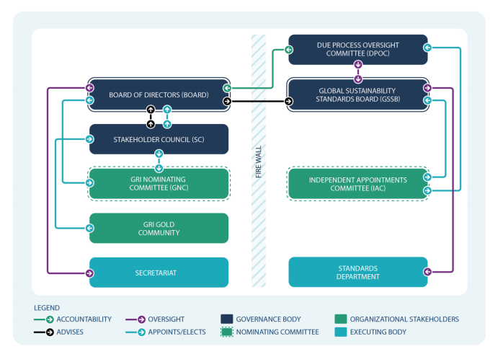
Governance structure

